Slide 1
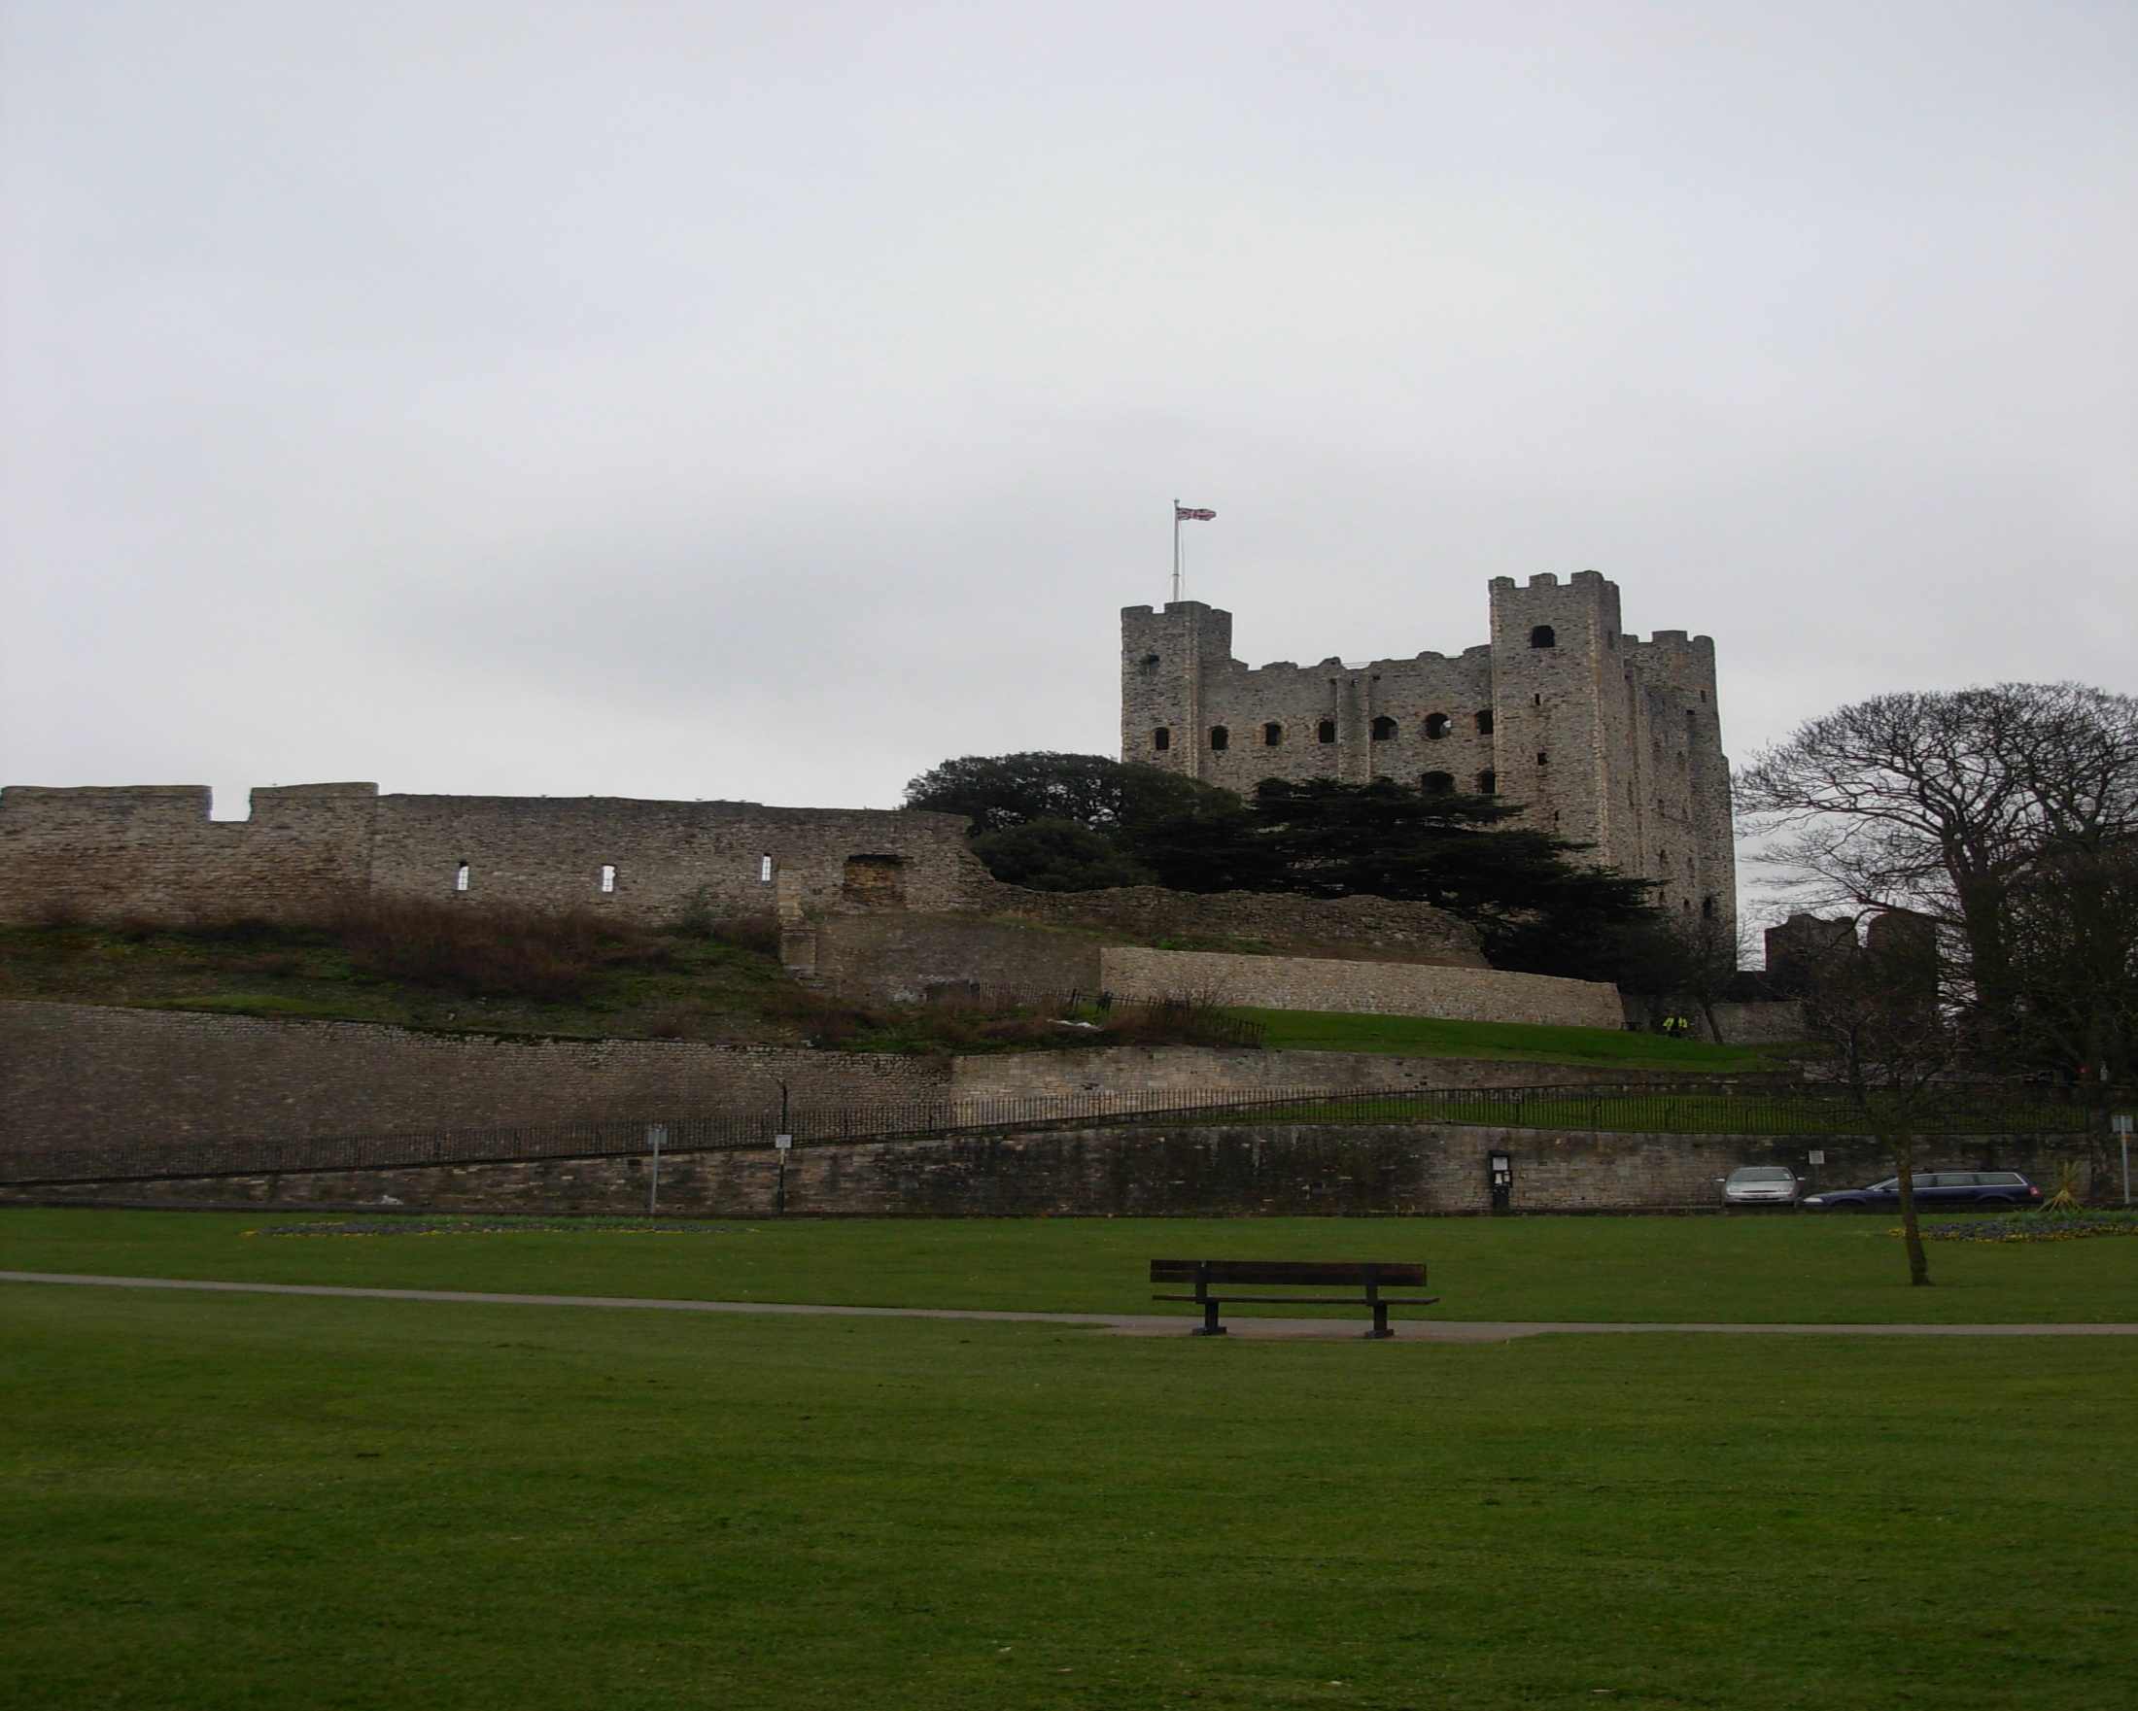
England trip

Slide 2
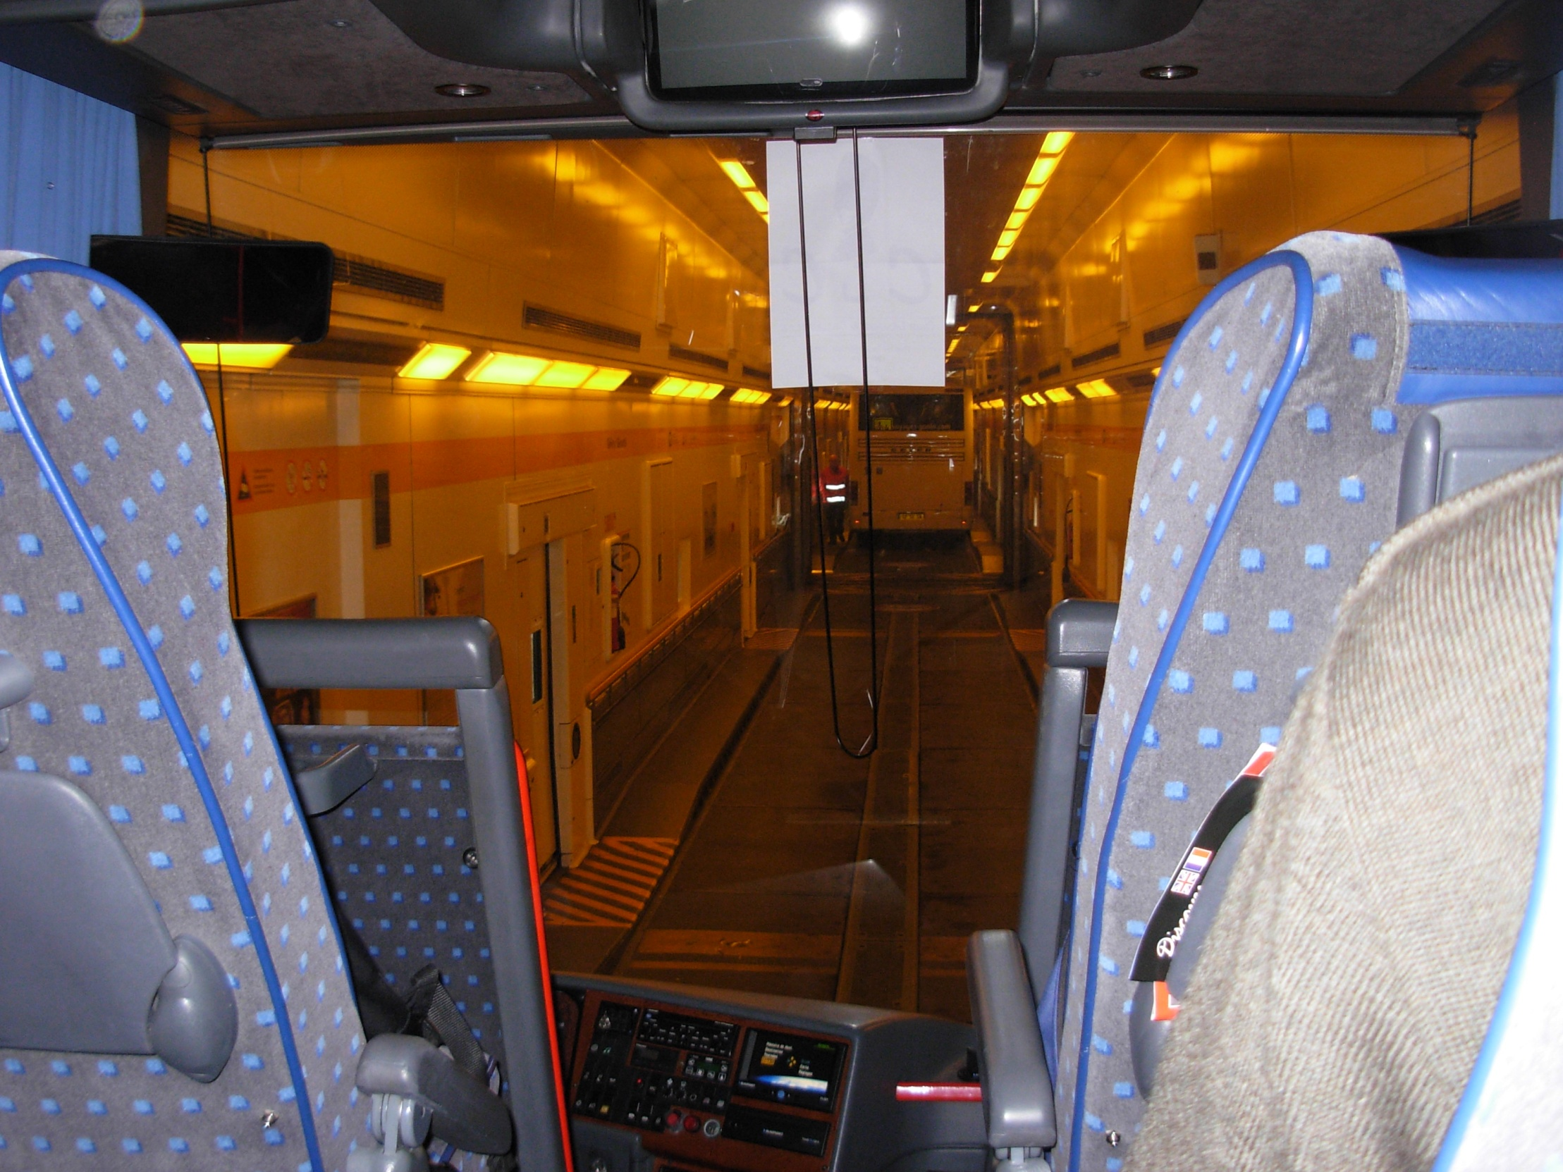
Monday at 11.3O p.m. we went to Calais to take the Eurotunnel

Slide 3
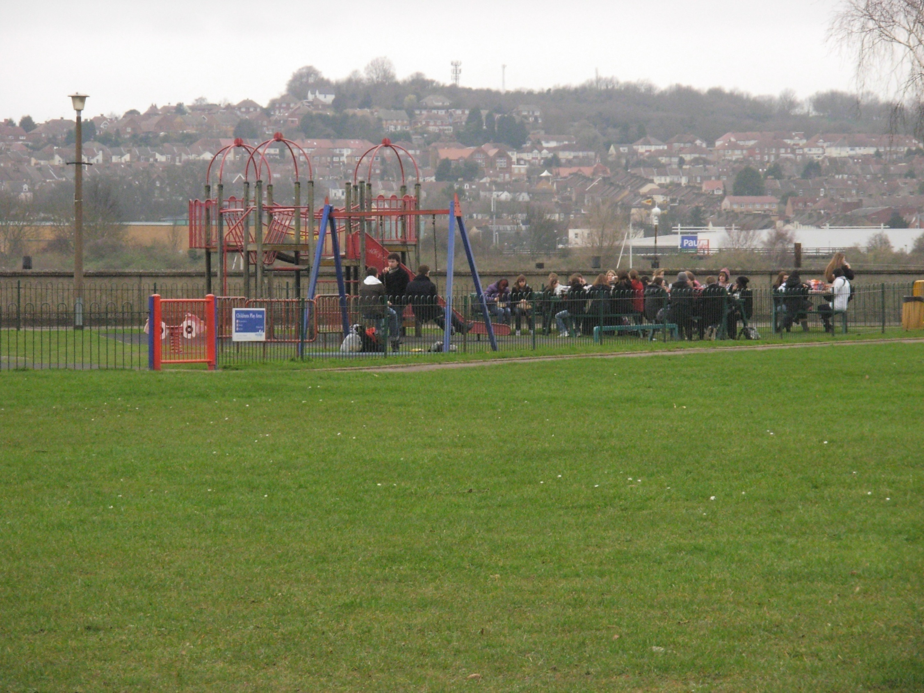
We ate at 1.00 p.m in Rochester

Slide 4
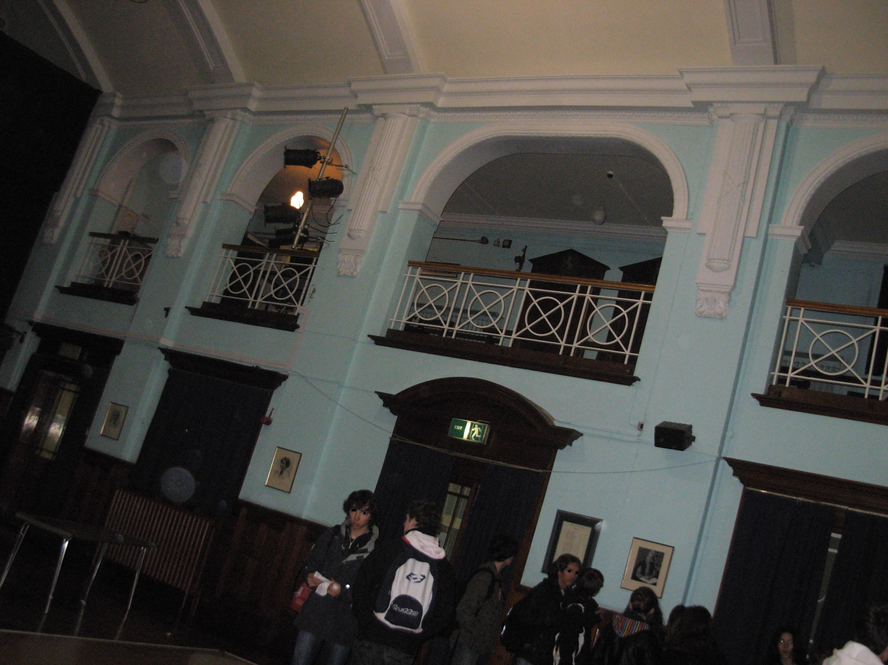
At 2.00 p.m, we visited the Chatham Girls Grammar School

Slide 5
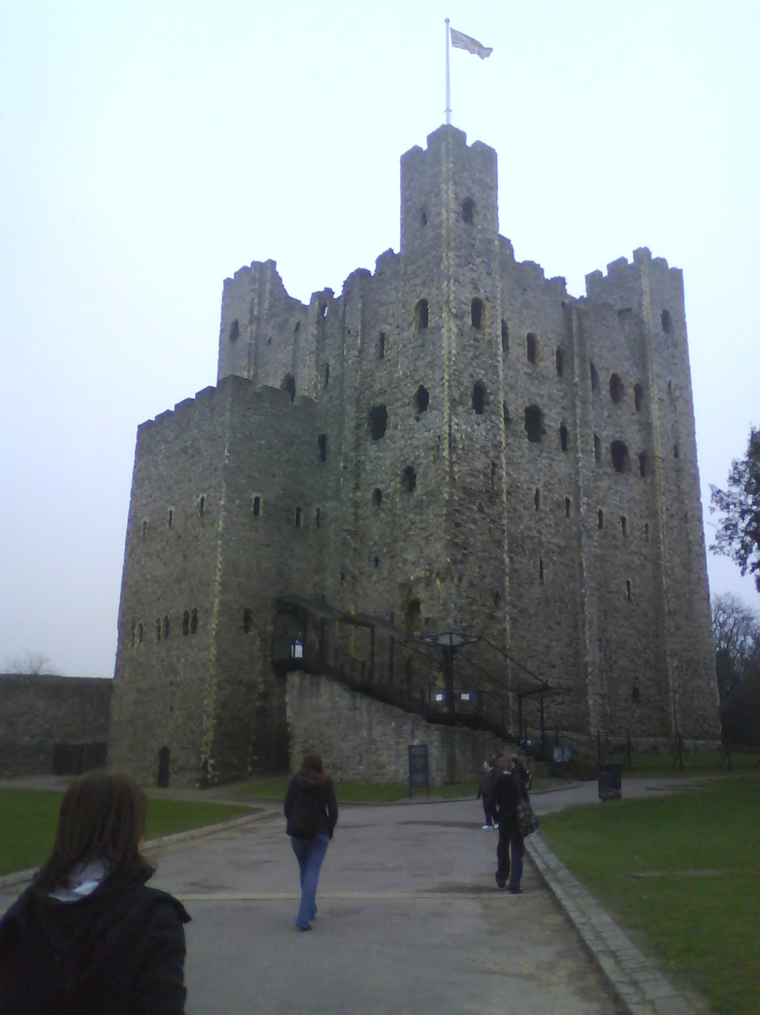
Tuesday, We went to Rochester Castle

Slide 6
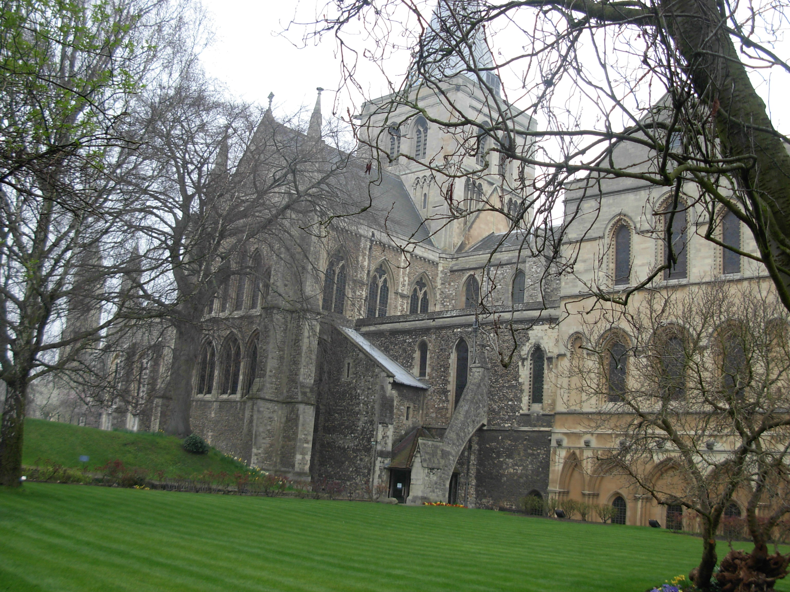
Wednesday, we visited Rochester Cathedral

Slide 7
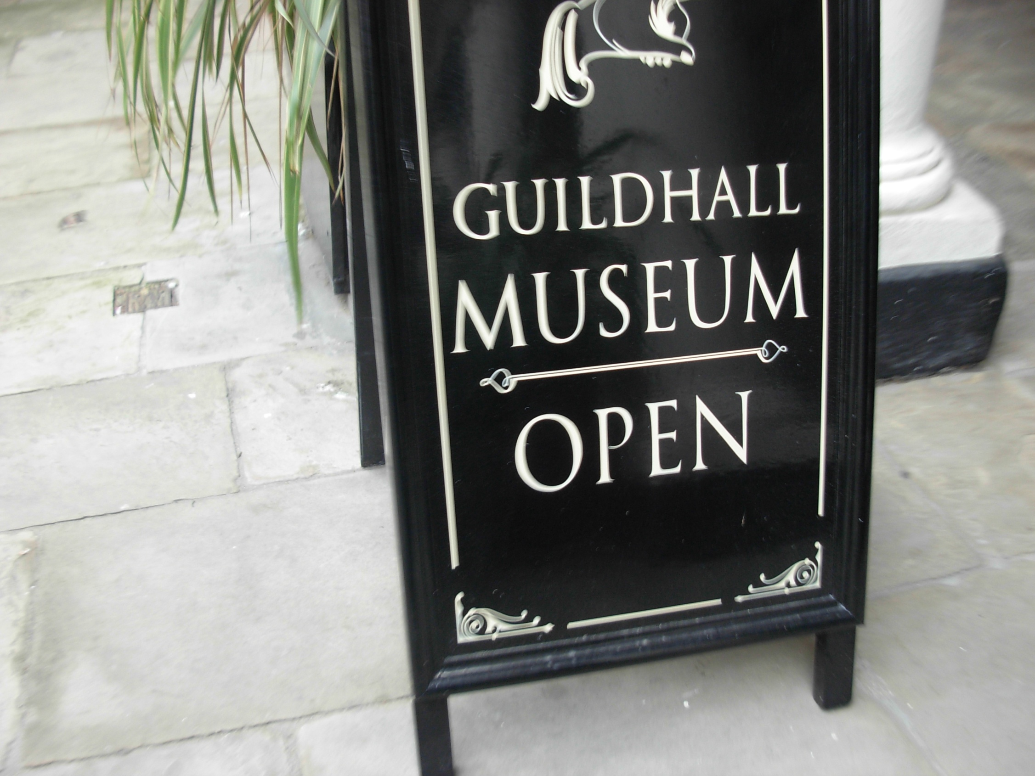
We went to
the Guildhall Museum
at 3.00 p.m

Slide 8
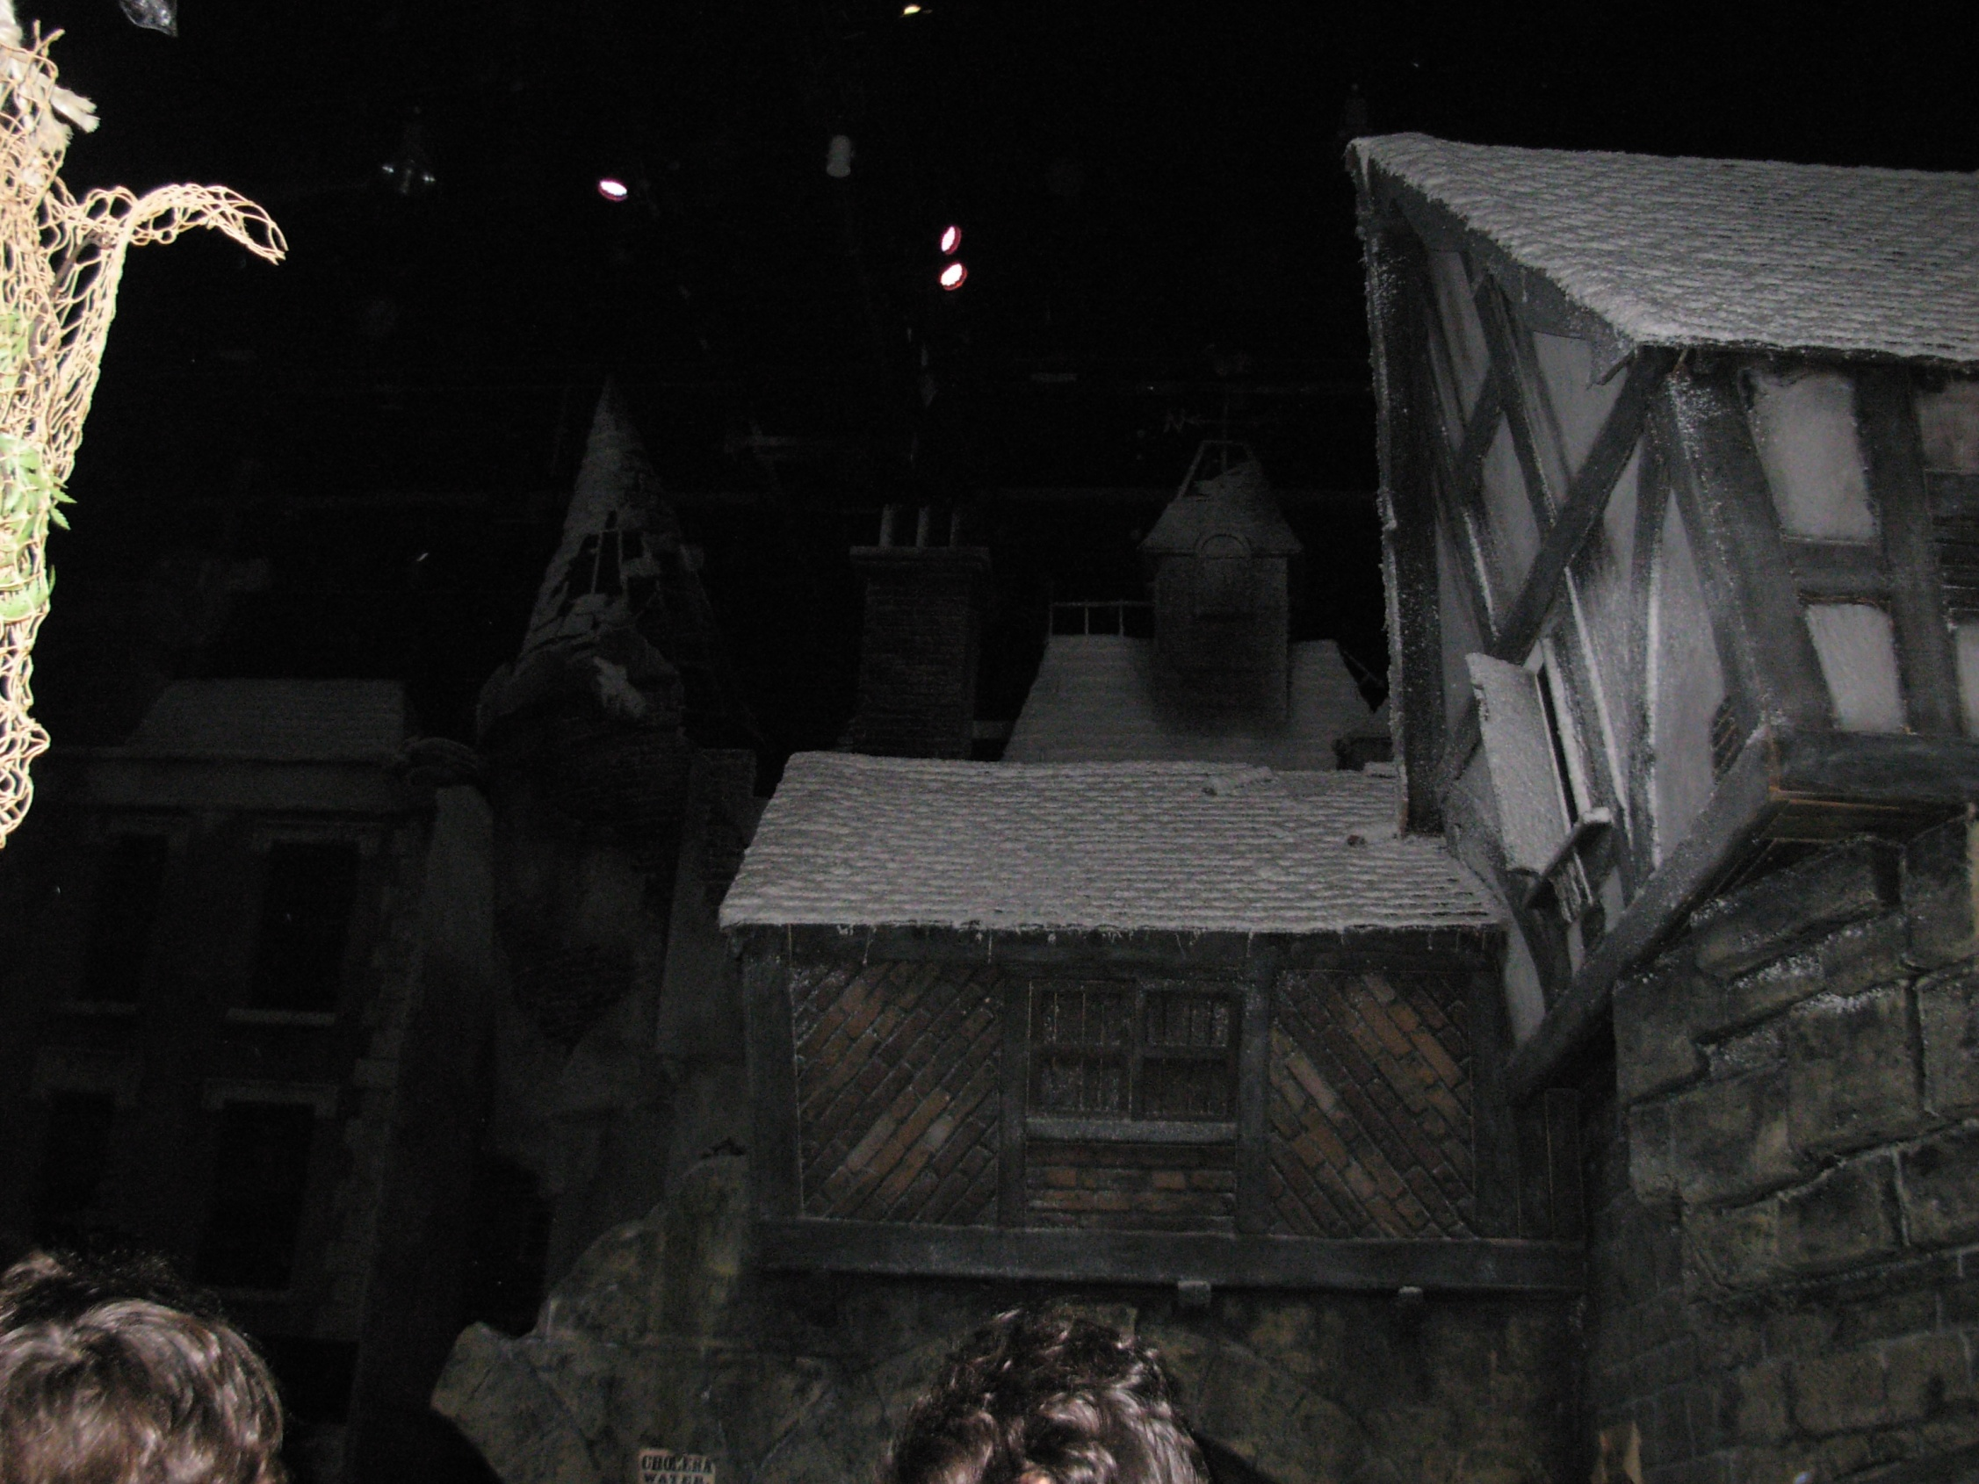
Thursday, we discovered
Dickens World
There are many attractions. It was great !

Slide 9
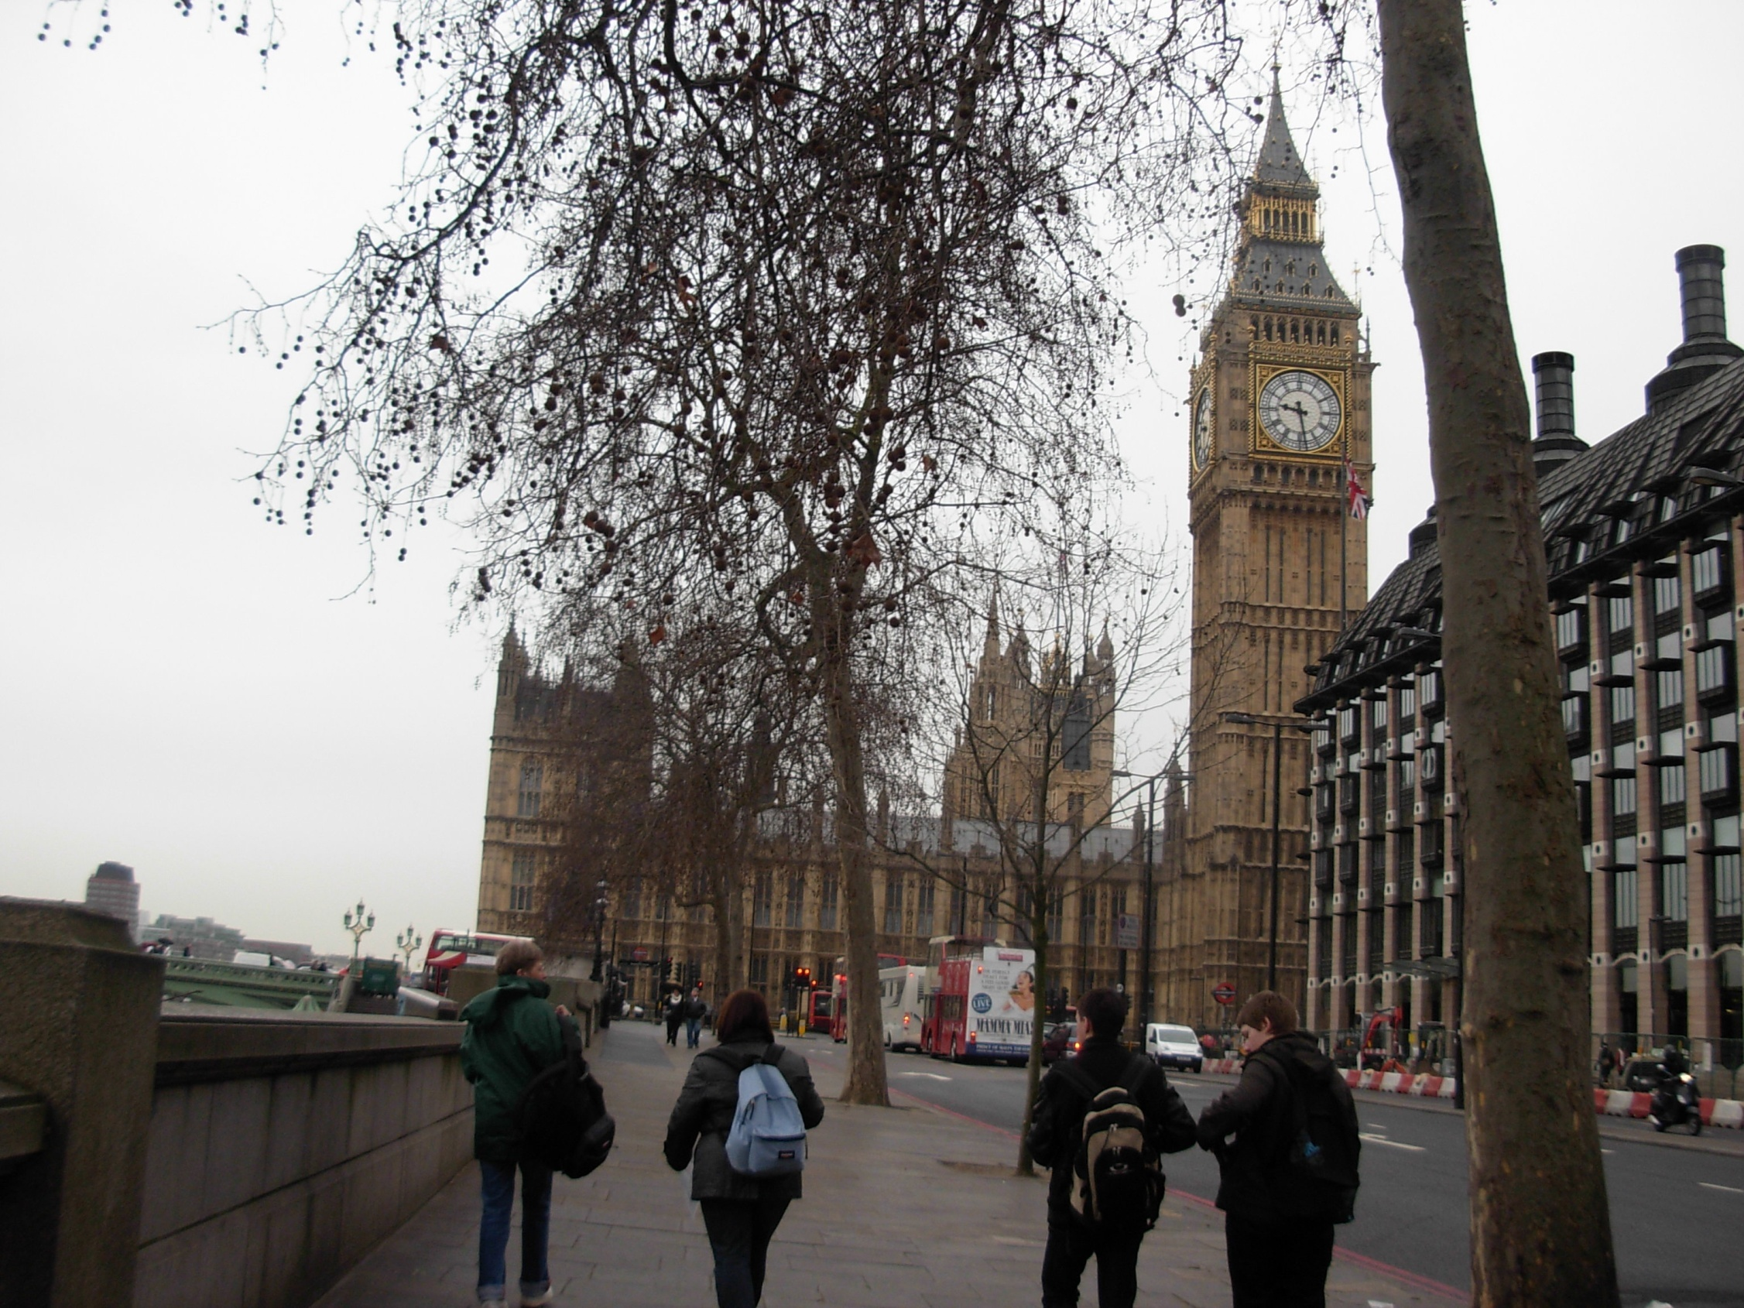
Friday we went to London to see some monuments (Big Ben, Westminster Abbey, Buckingham Palace..) and we went shopping in the afternoon.

Slide 10
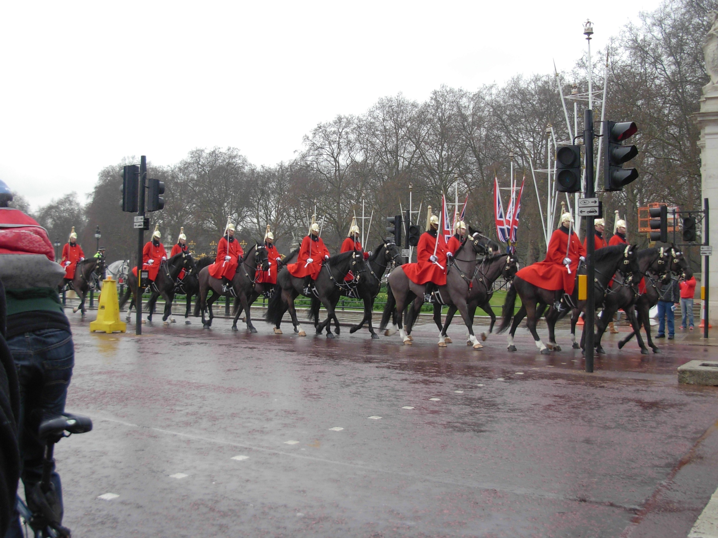
We were lucky to see the guards.

Slide 11
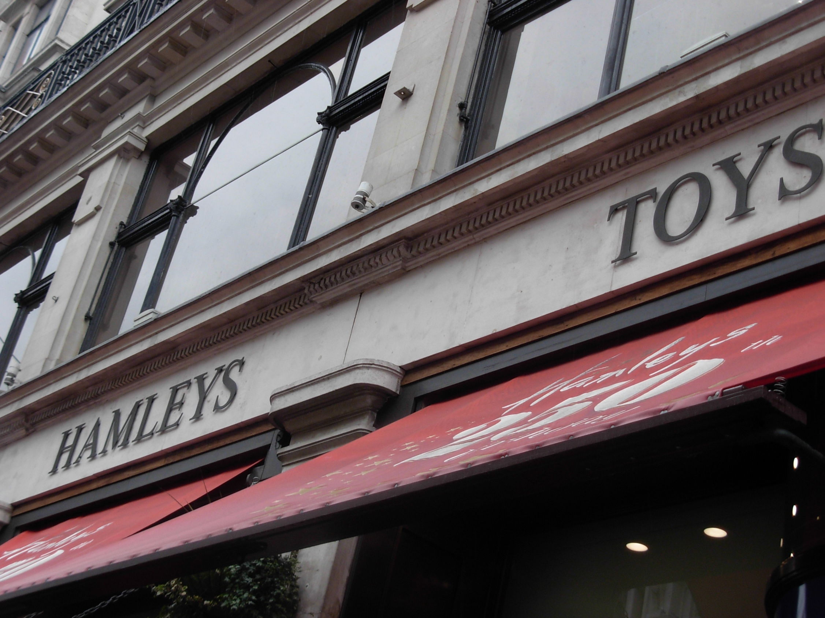
During our shopping we saw Hamleys, The fantastic toy shop !

Slide 12
We took the ferry and arrived in France at 2.00 a.m
This Trip was Amazing!

Slide 13
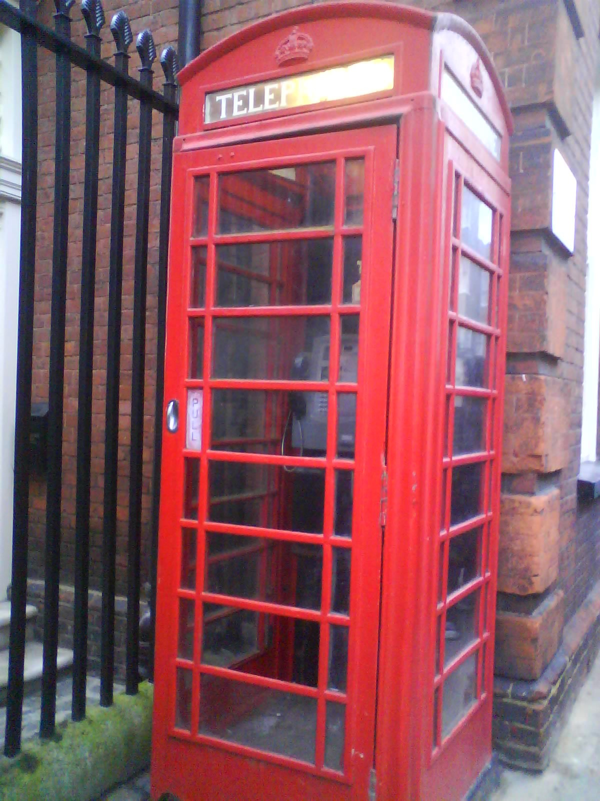
Ambre Barrat
Bénédicte Ponsard
Assia Giraud

