Slide 1
My trip to England

Slide 2
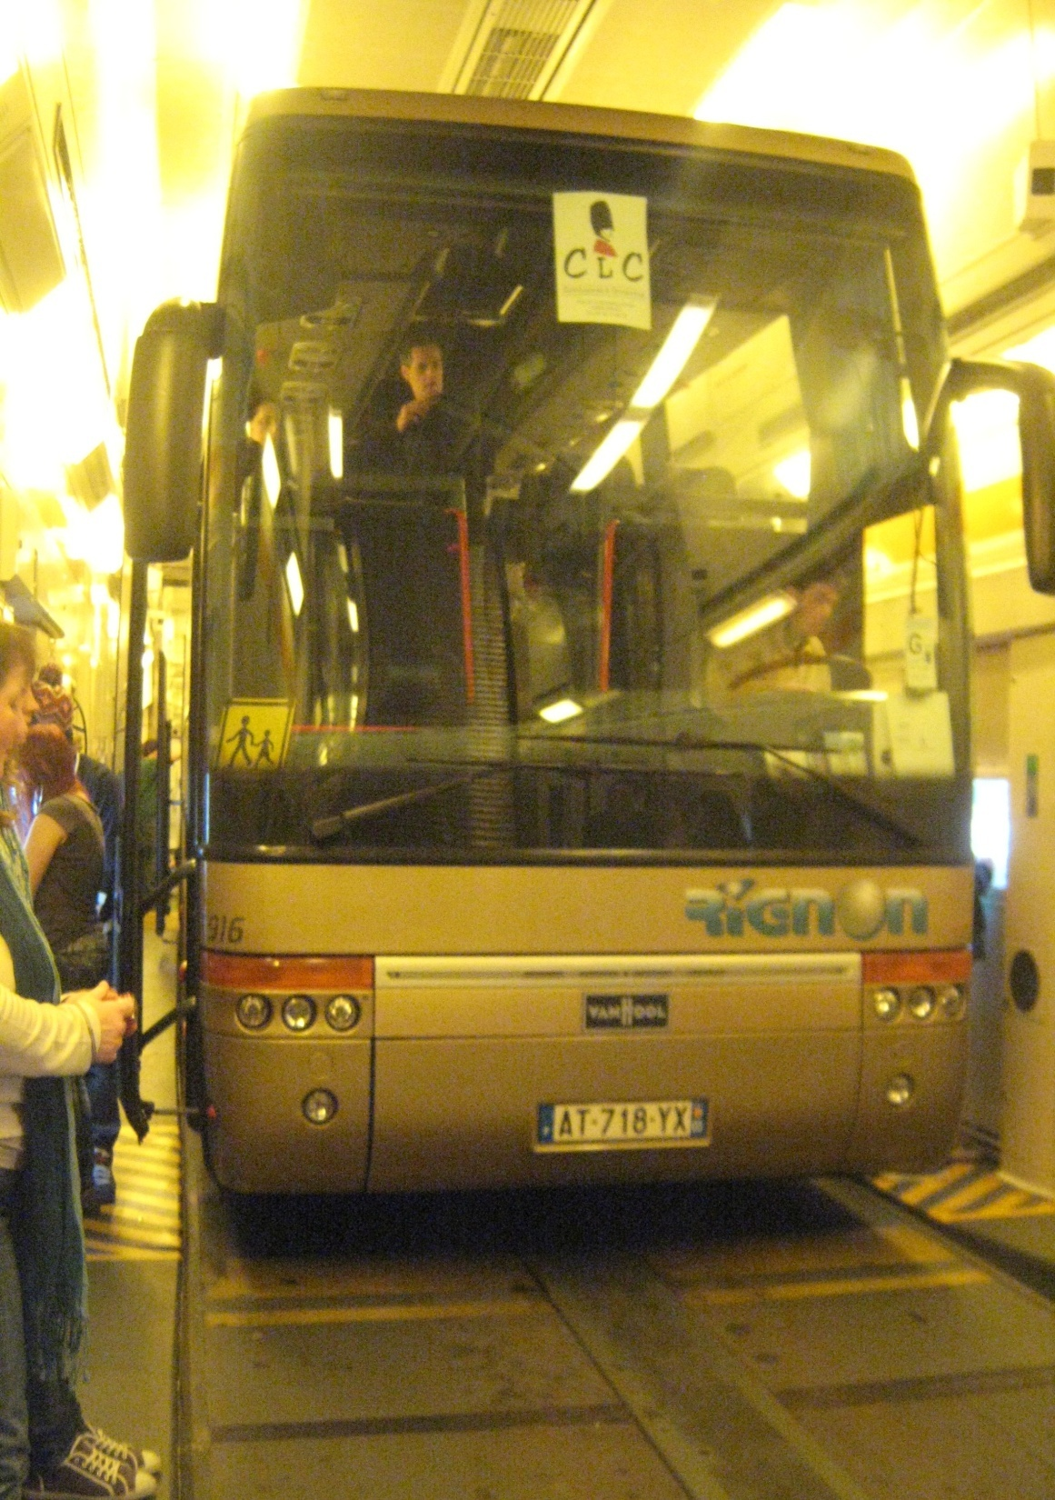
The Start
- We started Sunday at 11.45 p.m then we had a very long trip to arrive in England.
The afternoon we met with students of chatham girls’ grammar school.

Slide 3
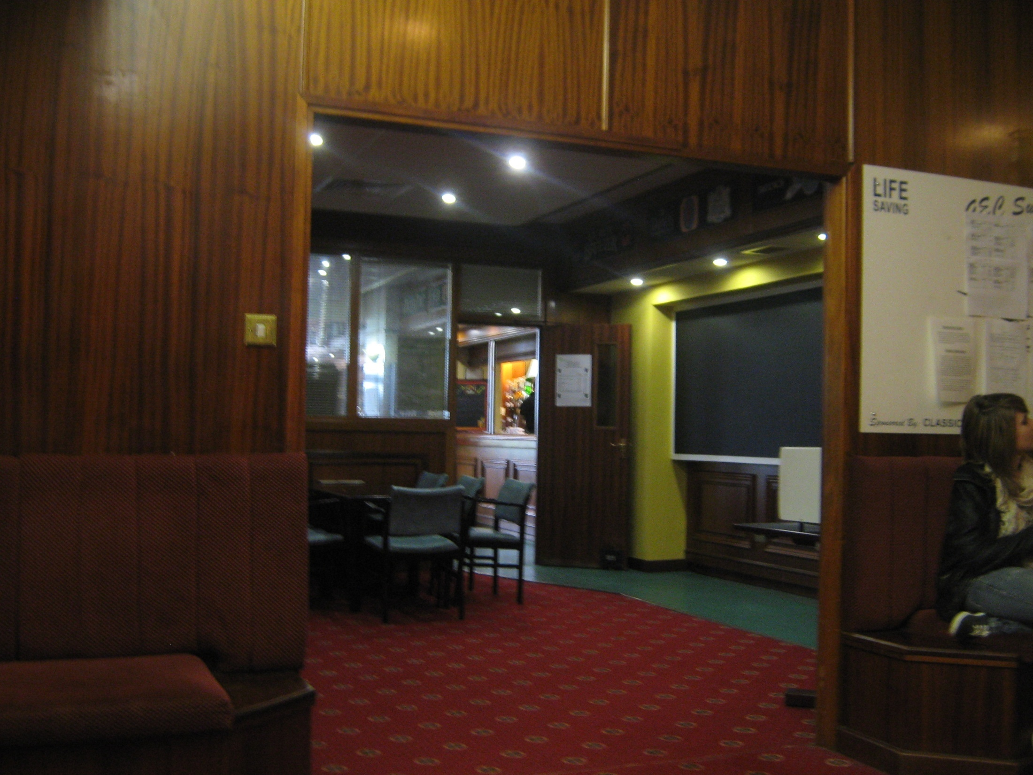
The second day
Every morning we had lessons in English with teachers of Rochester.
That day we did a test to know in which group we would work.

Slide 4
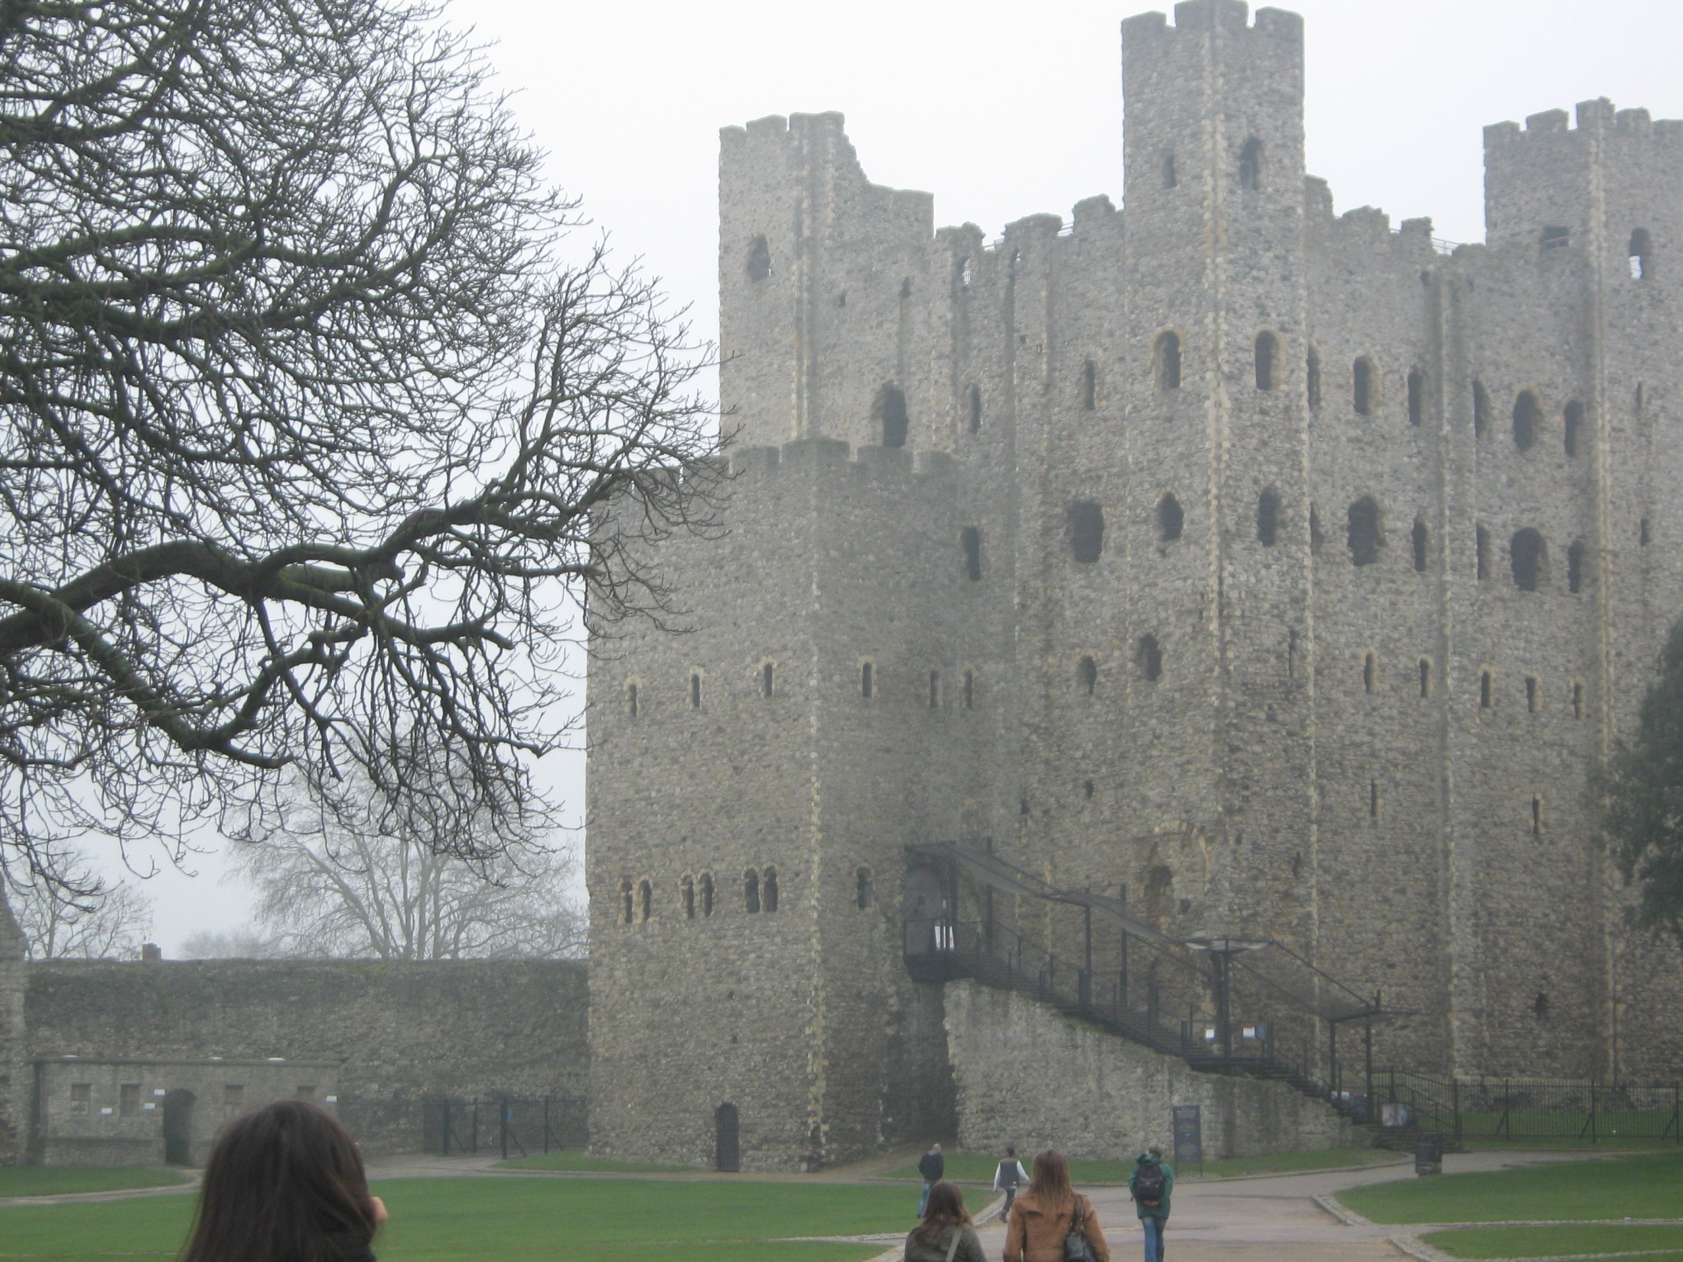
The second day
On the first day we visited the castle of Rochester.
I thought it would be a castle with furniture inside.

Slide 5
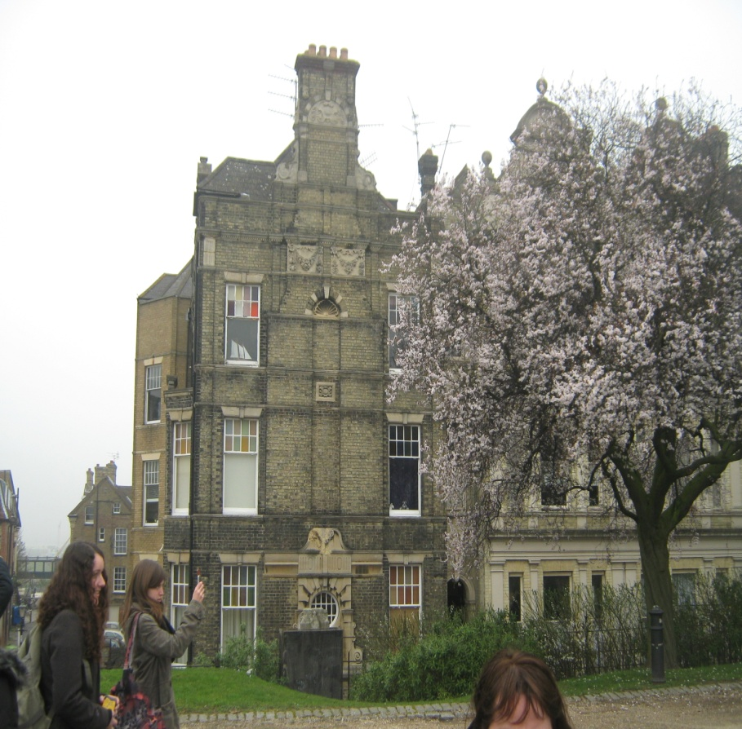
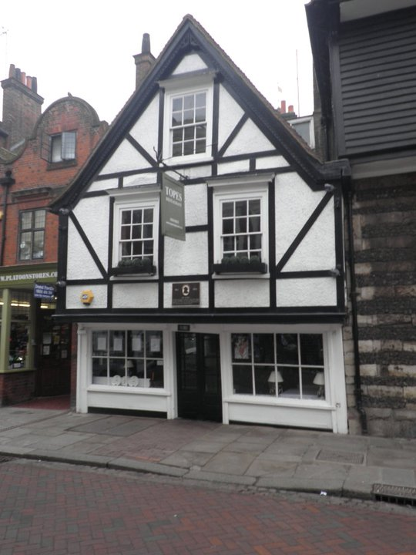
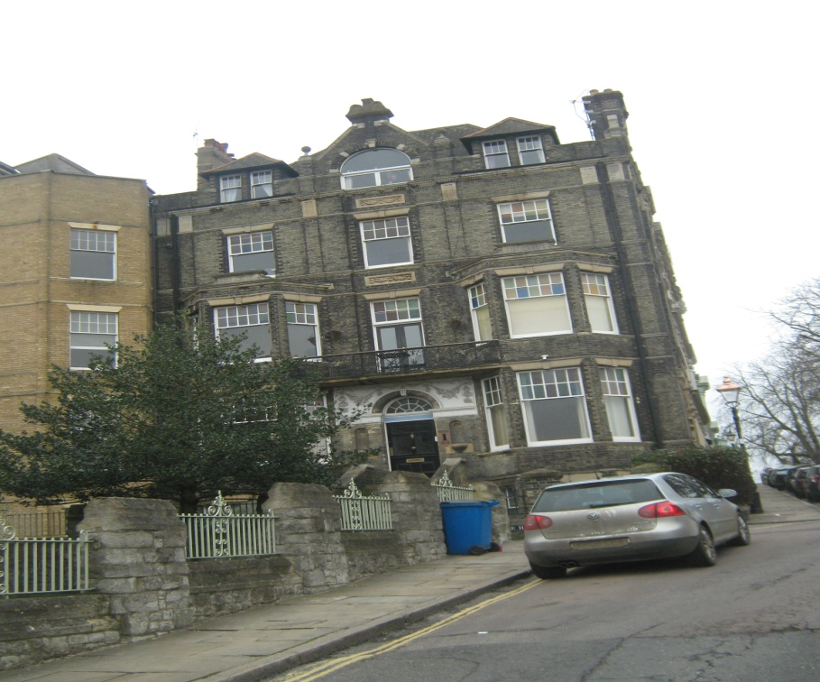
Rochester

Slide 6
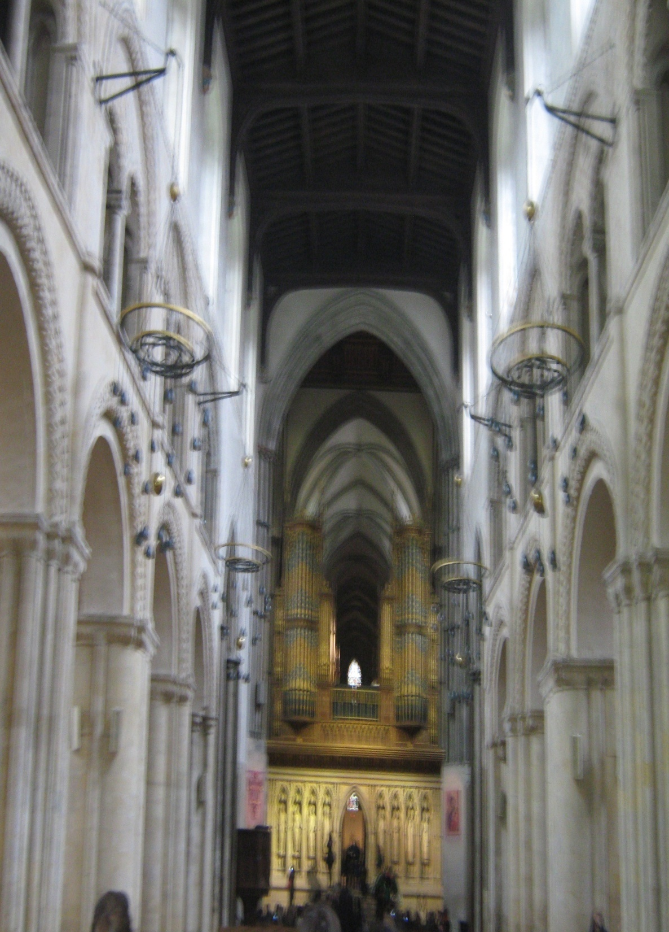
Day 3
We visited the cathedral in Rochester .
The garden of the cathedral and the interior of the cathedral were beautiful
but it was not my favourite visit.

Slide 7
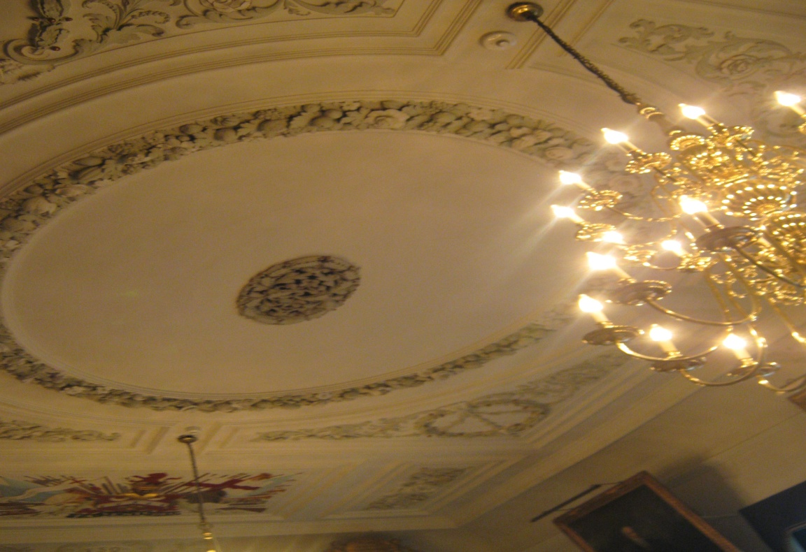
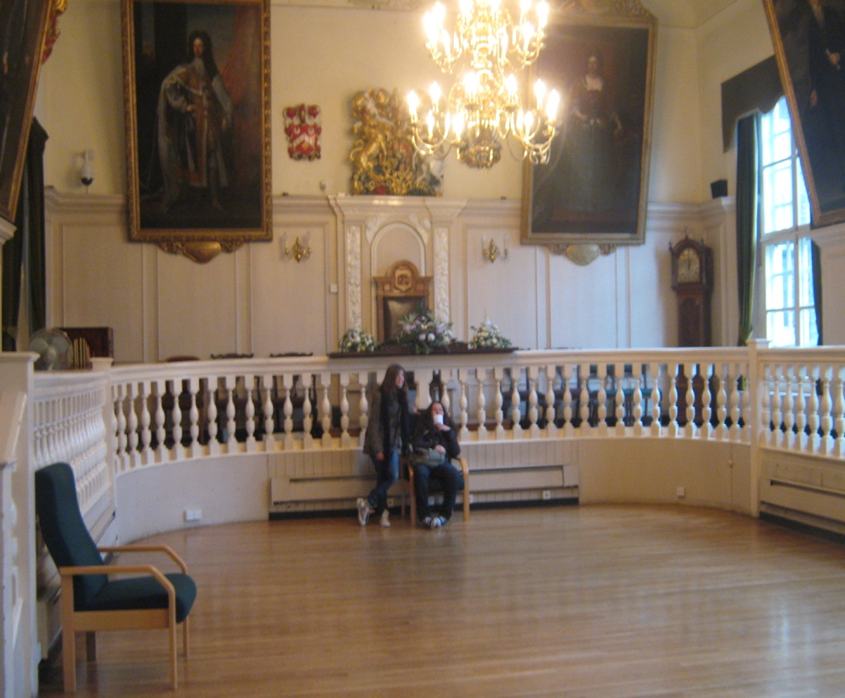
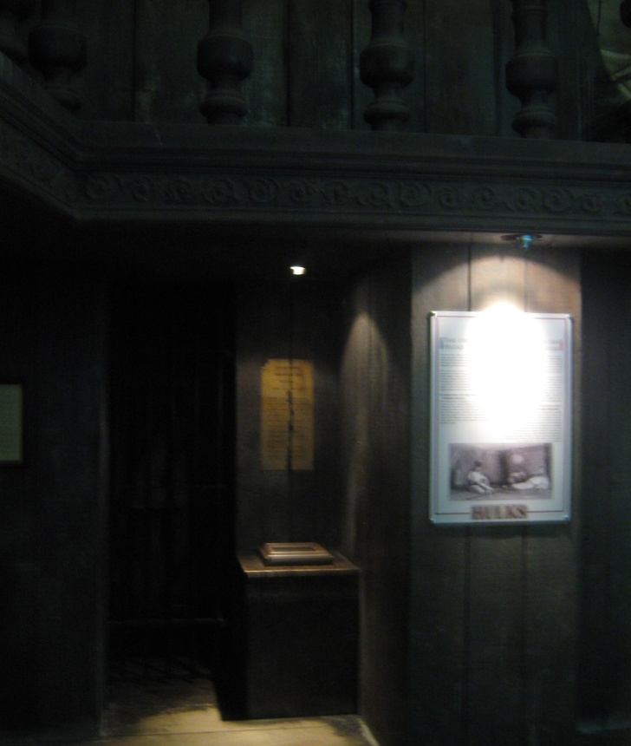
Day 3
And we visited the museum of Rochester.
This visit was strange because there were only a few explanations in the museum.

Slide 8
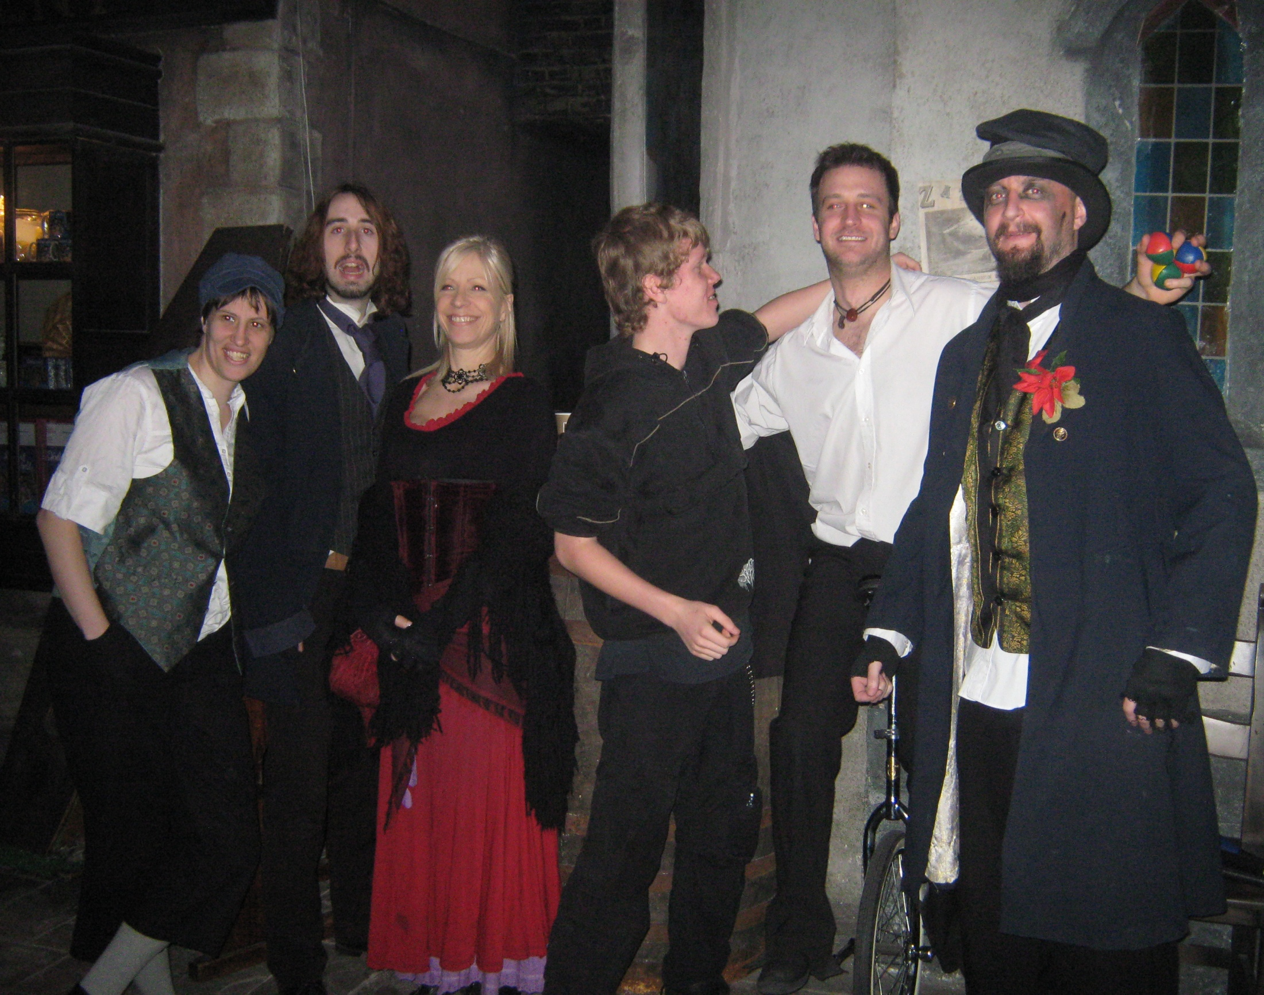
Day 4
We visited Dickens World. It’s my favourite day because the employees were nice and the scenery was beautiful. We talked a lot with them . The city is very well represented and there were a lot of animations as movies, theater plays, rides, etc.

Slide 9
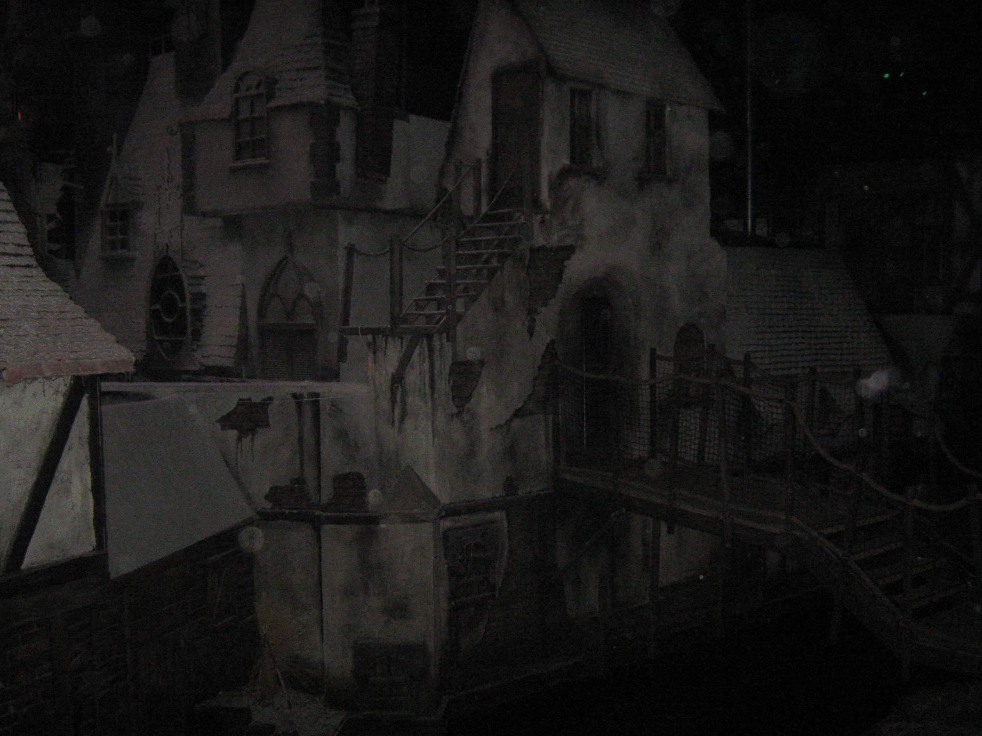
Dicken’s world

Slide 10
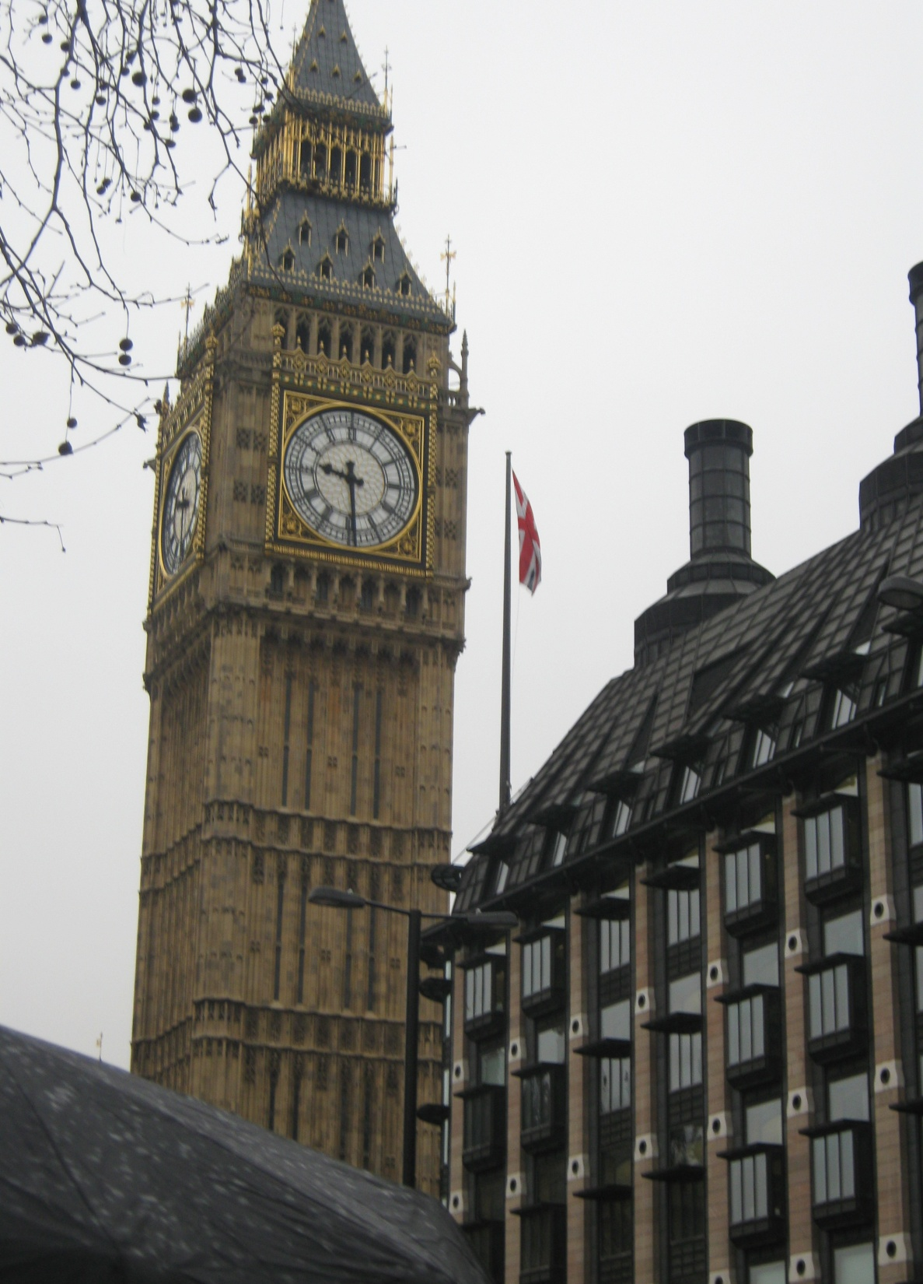
The last day
We visited many monuments in London
As :Buckingham palace,
Big ben and London eye .
Then we ate in an Indian restaurant and
in the afternoon we did some shopping in
London Streets.

Slide 11
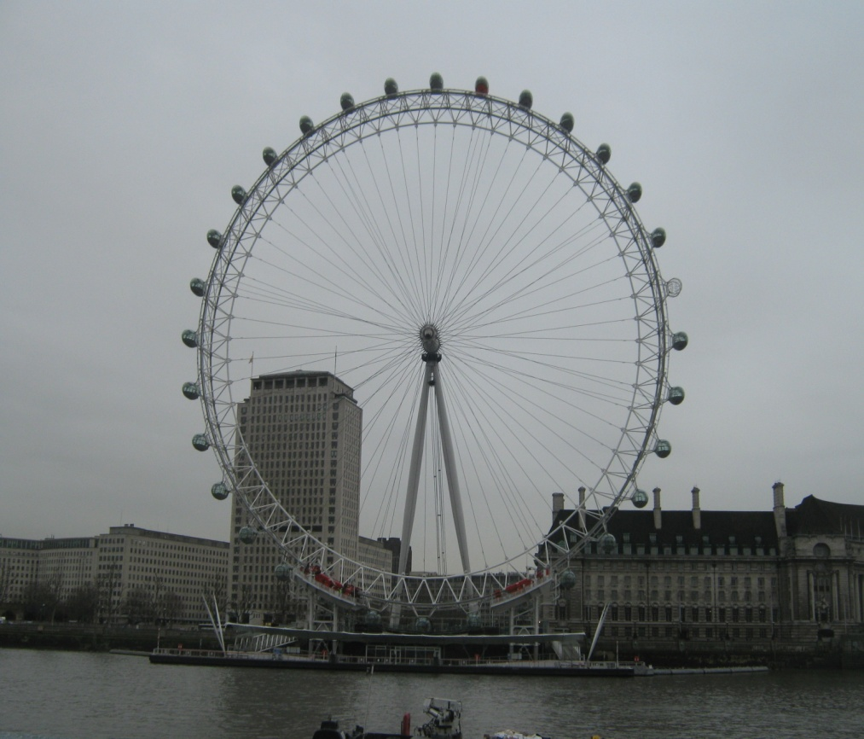
Monuments of London

